Slide 1
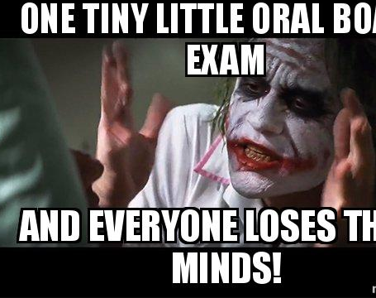
About Interactive Oral Assessments
A/P Wai-Man (Raymond) Liu
RSFAS

Slide 2
Issues
Have you struggled to engage with your students in class?
Have your students struggle with communicating what they know (and how do you know if they know?)
“I so look forward to a good question asked by my students, but none came ….”
In oral presentation, students may do well when given a well-crafted focused topic, but … how would they fare when confronted with questions outside the primary topic they prepare?
Conventional way of assessing cohort is too rigit
And …. I hate marking hand-written exam.

Slide 3
Where did it all begin?
Being the subject of IOAs and Objective Structured Clinical Examination (OSCE) …
Michael Sandel’s famous Justice course engage thousands of students in class through a socratic approach on moral reasoning
https://www.youtube.com/watch?v=kBdfcR-8hEY

Slide 4
About my course
FINM4017/8017 Trading & Markets
Delivery mode
Flipped class structure
Pre-recording + Face-to-Face lecture (In-person + Zoom)
Multi-modal approach
Course assessments
7 weeks in-tutorial trading games
The game feature was tailored specific to the topic I covered in the lecture
They need to write trading reports on the game they played
2x WATTLE quizzes
Since 2022, I incorporate Oral exam (mock/final)
Delivered in person / Zoom

Slide 5
Why oral exam (IOAs)?
Good indicator of students’ understanding and knowledge
They either know or they don’t
Mitigating issue of cheating using GenAI
Present opportunity to demonstrate their capability and personal interest in the subject matter
Opportunity to develop verbal communication skills – most jobs require some kind of verbal communication skills
Able to engage students’ learning
Able to intervene when students struggle
My experience
Notes:
AI “You post an assignment, and a student who struggles magically produces an incredibly well written response, however, when you ask in person they struggle to communicate” Dr Ryan Payne in his AI in Education

Slide 6
What did I do?
Good indicator of students’ understanding and knowledge
They either know or they don’t
Mitigating issue of cheating using GenAI
Present opportunity to demonstrate their capability and personal interest in the subject matter
Opportunity to develop verbal communication skills – most jobs require some kind of verbal communication skills
Able to engage students’ learning
Able to intervene when students struggle
My experience
Notes:
AI “You post an assignment, and a student who struggles magically produces an incredibly well written response, however, when you ask in person they struggle to communicate” Dr Ryan Payne in his AI in Education

Slide 7
Things I have done to help
Engage students during their Face-to-Face lecture and advise them to be pro-active
Strategy to nail the oral exam:
Be prepared!
Simulate exam situation
Teach them to create a structure of response to address the question directly
Clarify the question
Demonstrate how to support the argument with example
Kept reminding them: Doom to fail if you don’t practice
Engage every student in the lecture

Slide 8
It was estimated that 15 minutes of IOAs is equivalent to 3,000 word text-based Essay (Danielle Logan-Fleming and Popi Sotiriadou from Griffith University)

Slide 9
Structure of IOAs
Mock exam: 1/10 questions – 5min, week 10, conducted through Zoom
Final oral: 3/60 questions – 15 min
How to structure your questions?
Interactive approach
In person – all recorded
Consent process
Marking rubrics:
Completeness of responses (40%)
Accuracy of responses (40%)
Overall depth and breadth of knowledge (10%)
Oral communication skills (10%)

Slide 10
How … specifically
Contextualise questions, build them around a story / case / scenario
Teach them how to address them in a structured way
Defining questions
Providing answer specific to the questions
Providing empirical evidence / example to support your answers

Slide 11
Challenges
Have consultations with people from School of Engineering, Languages
Bronwen Whiting, Chris Browne, Catherine Galvin
Managing expectations
By producing a pool of questions help create a “false” safety
Make sure you are NOT providing answers to those questions prior to exam
Could be quite challenging to assess students to solve a mathematical problem
What if they fail?
Privacy concern

Slide 12
Feedback from students
“The oral exam was also an excellent way to motivate the students to truly understand the concepts. This method of examination, in my opinion, is better as it makes no sense to subject students to tough questions under a closed/open book exam. The oral exam is a much better way to accurately evaluate a student's true learnings and worthiness to pass the subject” (2023)

Slide 13
Feedback from students
“The oral-format final assessment was also particularly meaningful for me. I was initially someone who tended to be hesitant about speaking up in front of others, especially when unsure of my views. Through the preparation process and the structure of the course assessments, I became more comfortable articulating and defending my reasoning in a clear and professional manner. This experience has had a lasting impact on my confidence in presenting and justifying investment-related decisions, which I now recognise as a critical skill for strategic and project-based roles.” (2025)

